Slide 1
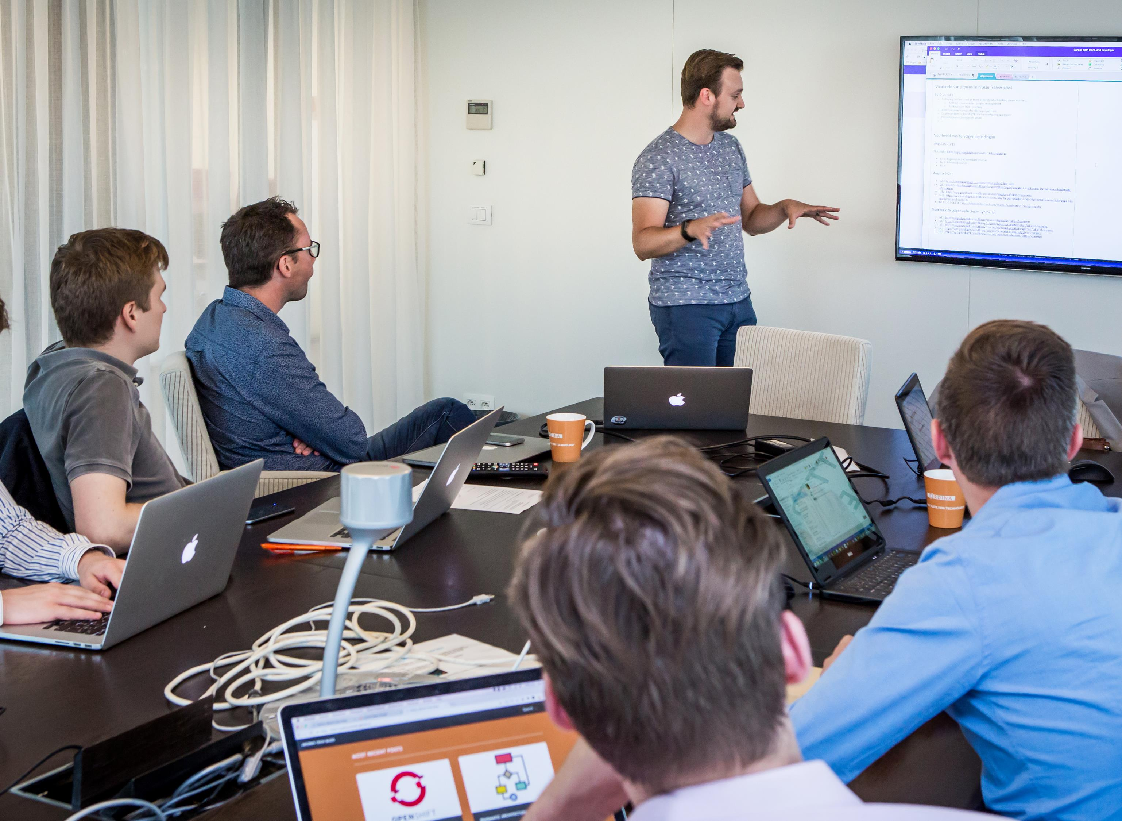

Kick Start Program
Image processing and computer vision

Slide 2
MOTIVATION
Accurate and precise blood evaluation plays a crucial rule.
Pathogen detection and cell identification.
Fast and high-throughput process are required.
Complete Blood Count (CBC).

Slide 3
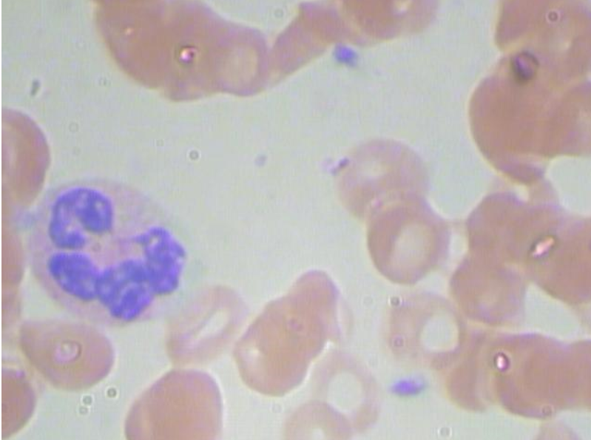
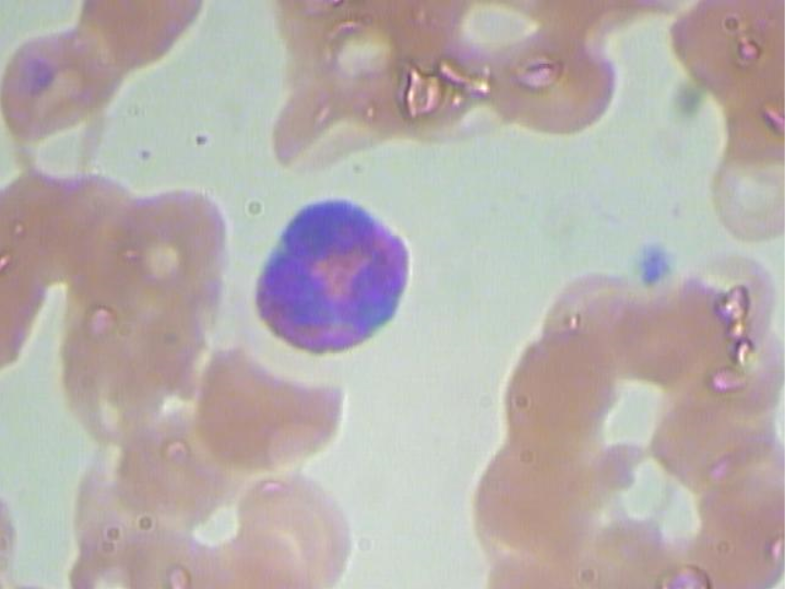
BACKGROUND
Complete blood counting (CBC).
Blood cell (BC) detection
Wide range of disorders (leukemia, anemia, malaria).
In the past, mostly manual labor.
Currently, computer-aided systems.
Could AI play a role?

Slide 4
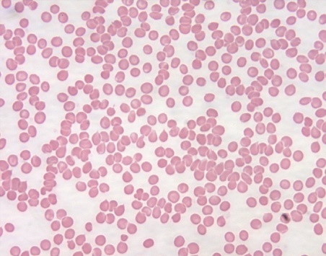
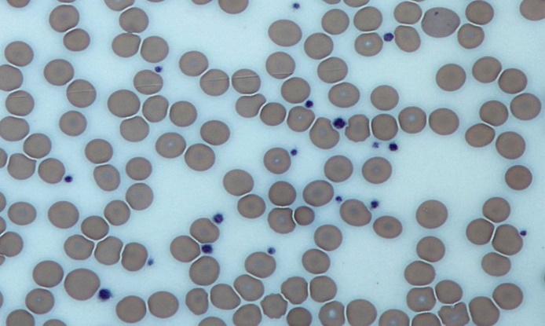
Blood cell types
Red blood cells (RBC)
Oval-like flat shape
Major role → gas carriers
Low amounts→ anemias
Platelets
Tiny spots
Major role → clog formation
Low amounts→ leukemias

Slide 5
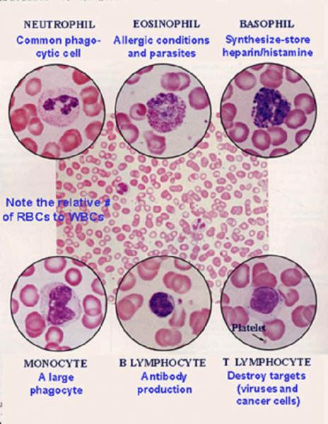
Blood cell types
White blood cells (WBC)
Leukocytes → immune system response
Different types → different diseases or medical conditions
2 groups → Granulocytes vs agranulocytes

Slide 6
APPROACH
The case consists on 2 main tasks:
Identify different types of cell and its locations in the image.
Classify the different categories of WBC (or WBC groups)

Slide 7
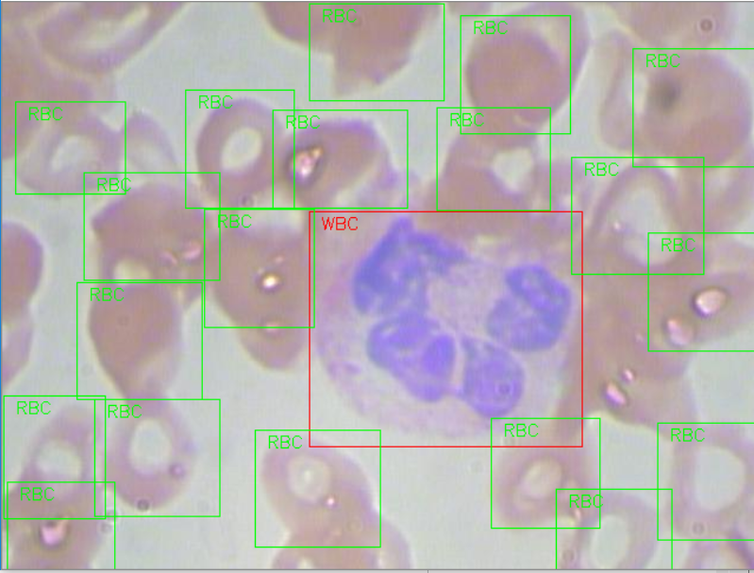
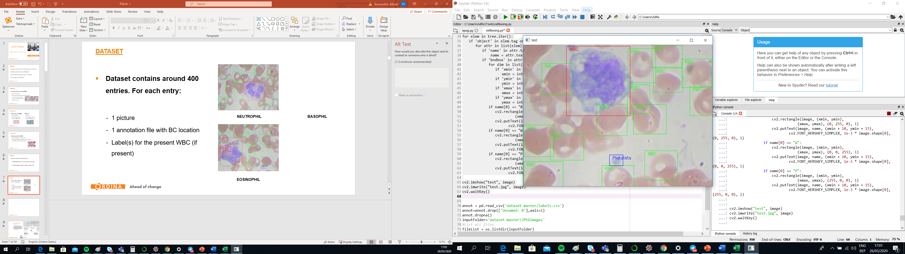
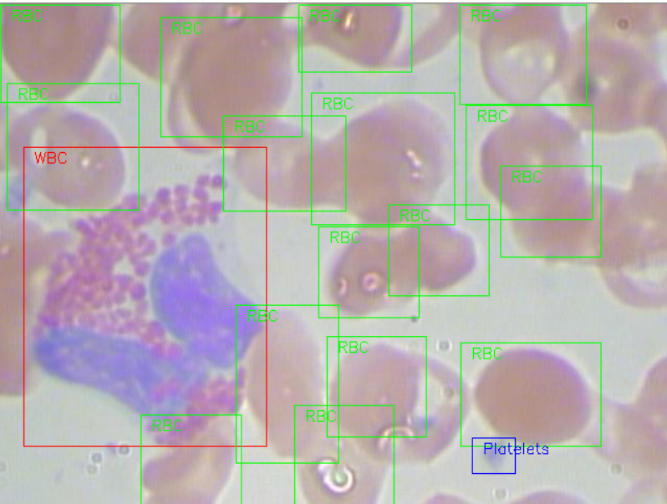
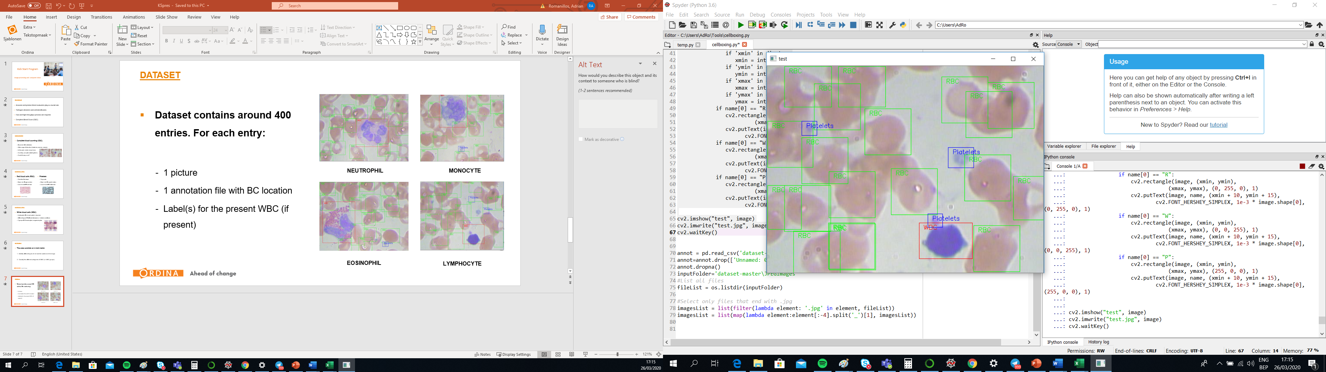
DATASET
Dataset contains around 400 entries. For each entry:
1 picture
1 annotation file with BC location
Label(s) for the present WBC (if present)
NEUTROPHIL
MONOCYTE
EOSINOPHIL
LYMPHOCYTE

Slide 8
DATASET
Pictures (.jpg) and annotations files (.xml) files are located in a server.
Cell identification results must be stored in a new file
WBC labels are found in a SQL database.
Classification results must be stored in the same database

Slide 9
DELIVERABLES
Computer vision algorithm
Real time demo of the results
Testing other datasets?

